Slide 1

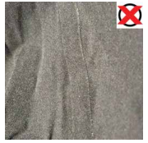
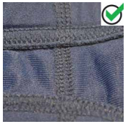
Tech Suit Guidance for 12&U Swimmers
Bonded Seems (not allowed)
Stitched (Sewn) Seems (ok)

Slide 2
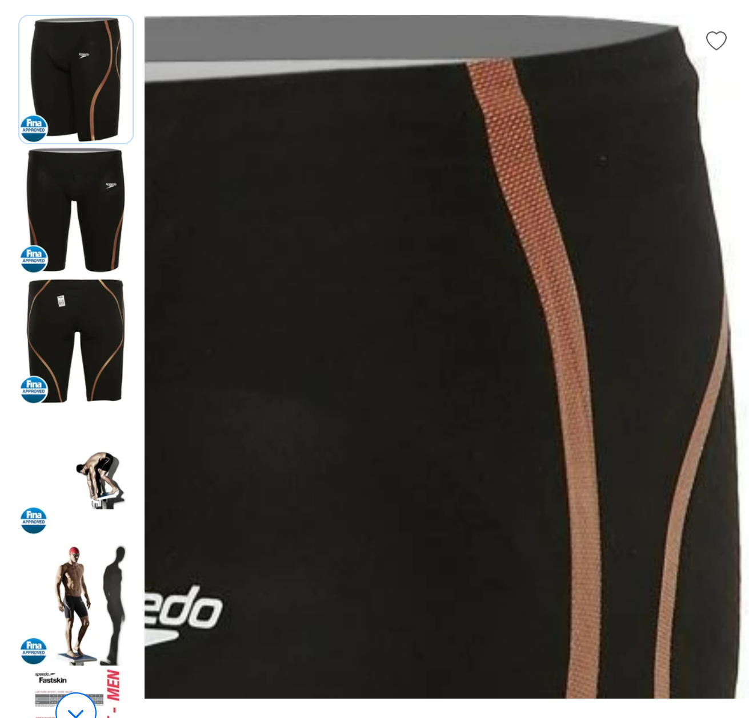
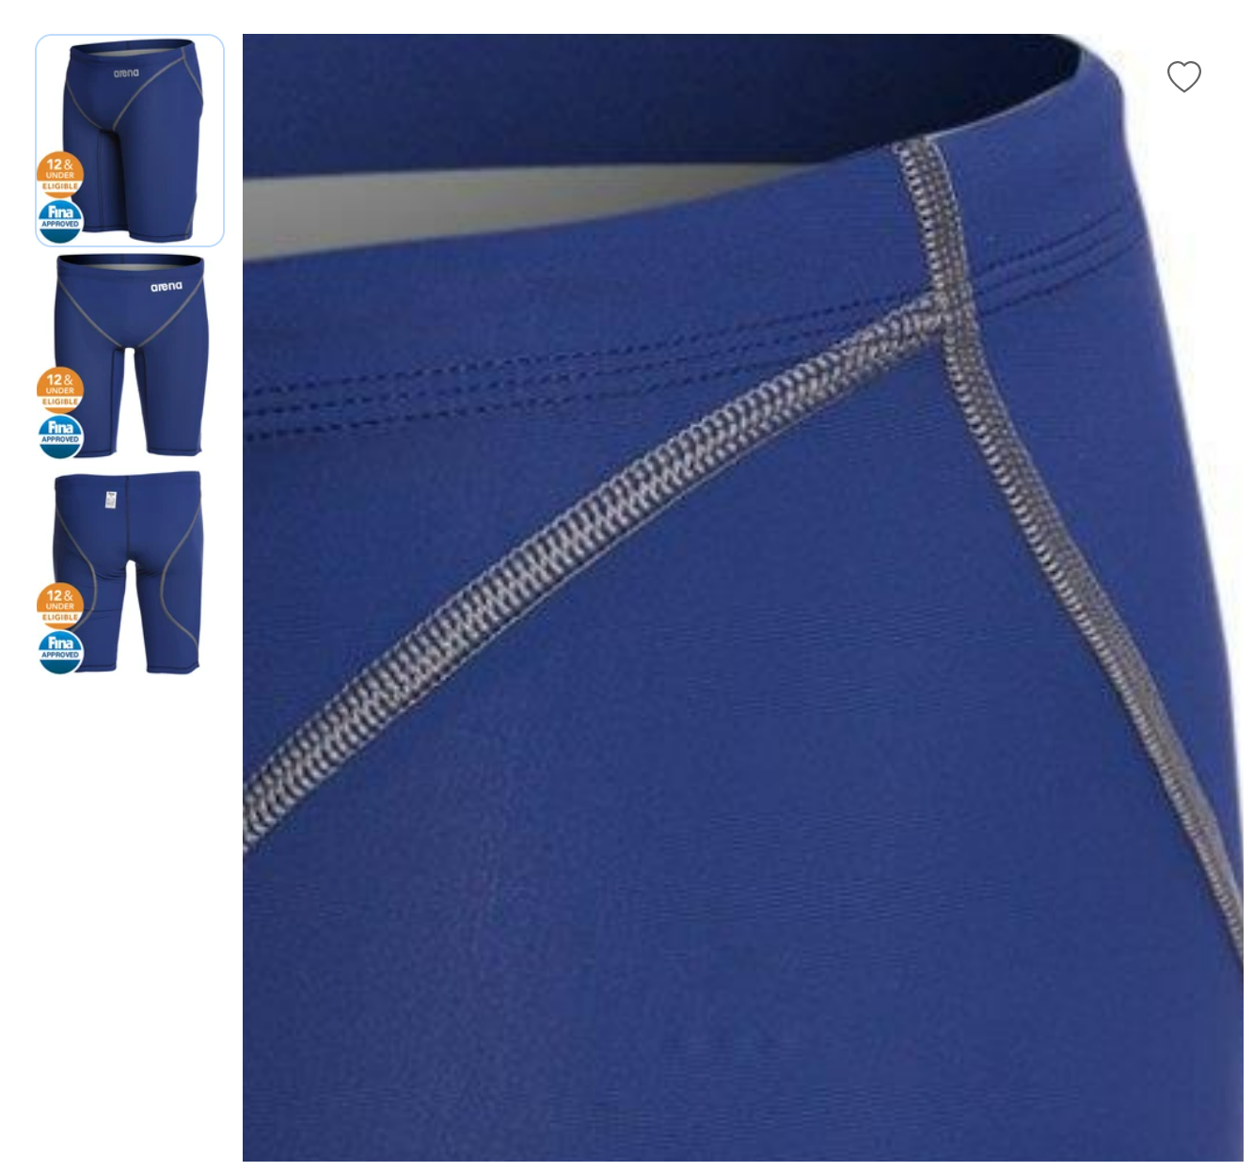
Tech Suit Guidance for 12&U Swimmers
Bonded Seams
Stitched (Sewn) Seams

Slide 3
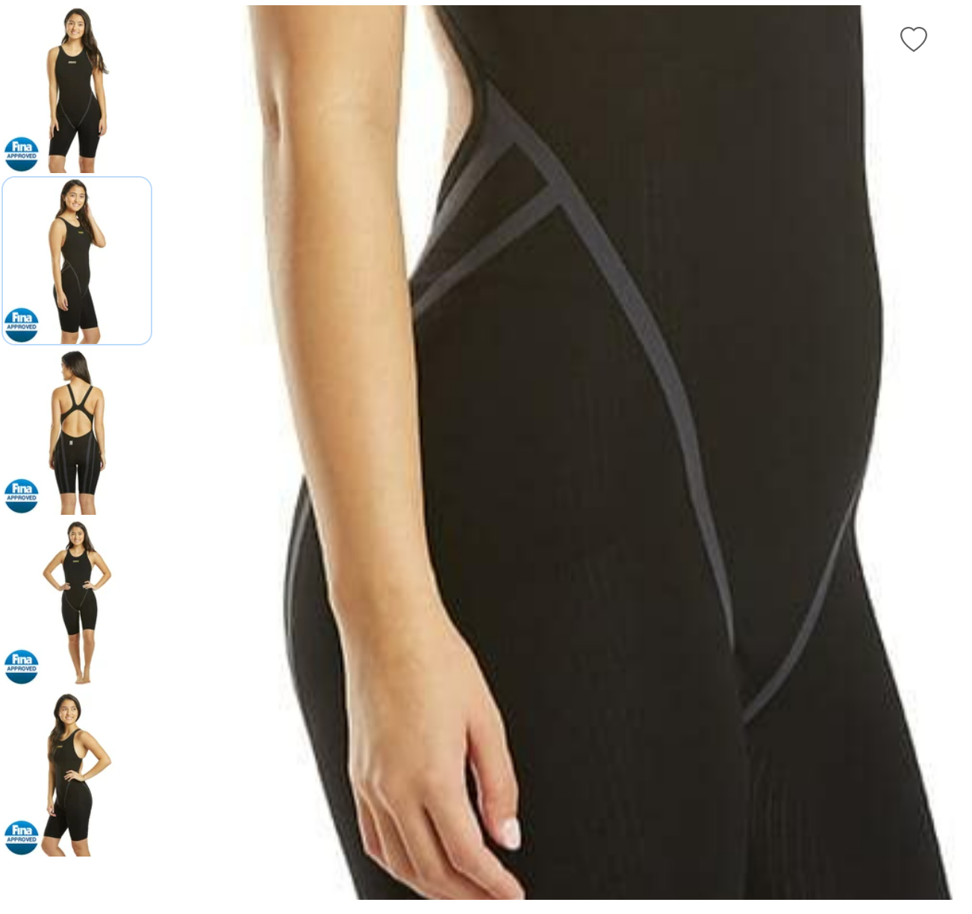
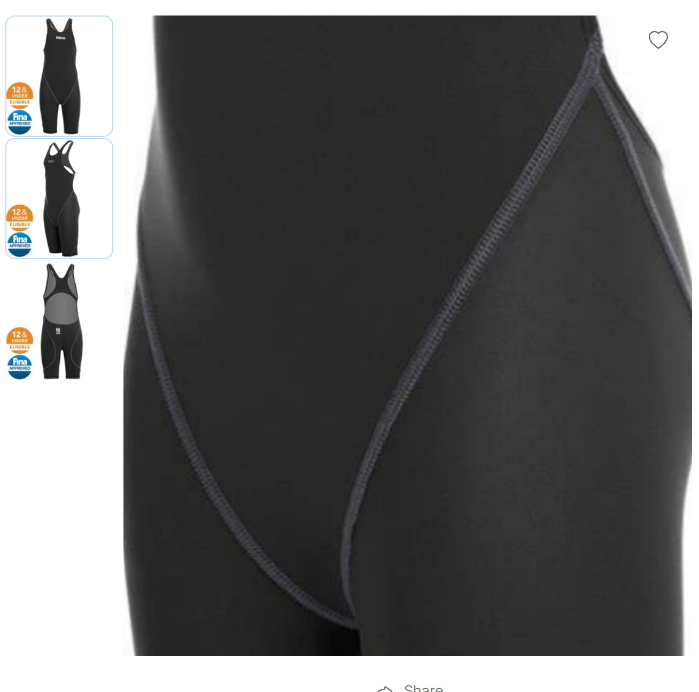
Tech Suit Guidance for 12&U Swimmers
Bonded Seams
Stitched (Sewn) Seams

Slide 4
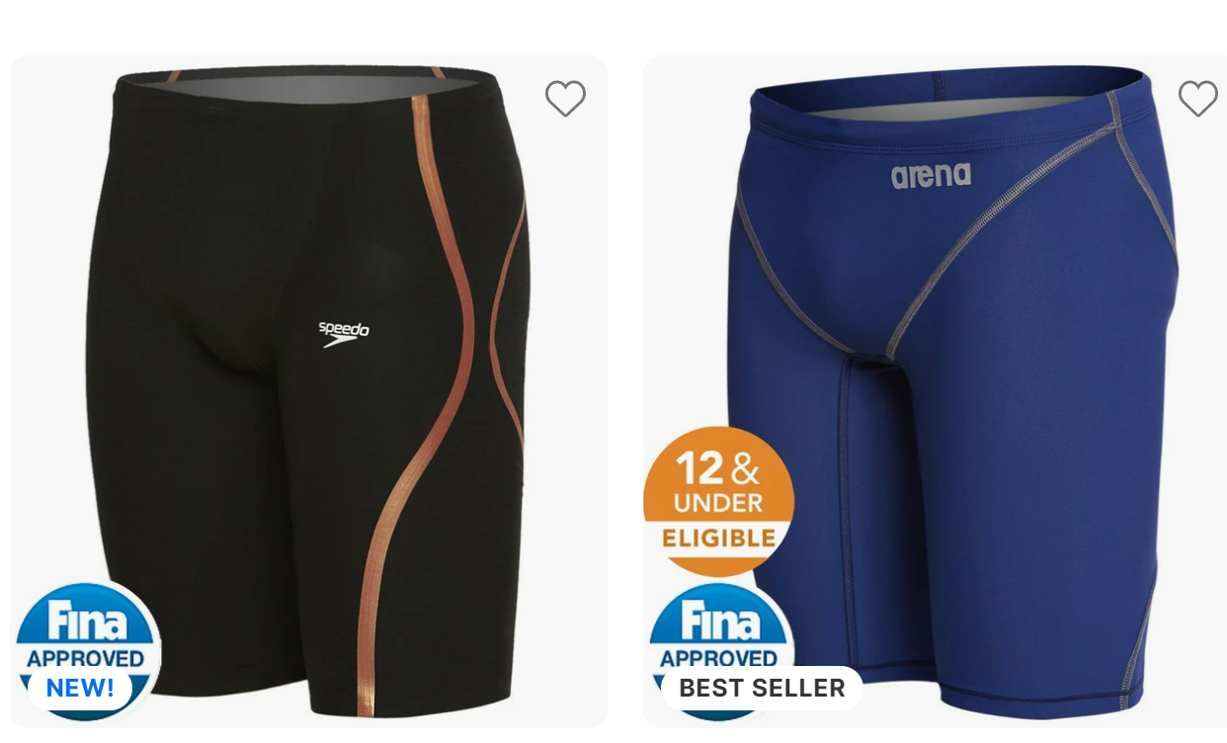
Tech Suit Guidance for 12&U Swimmers
Bonded Seams
Stitched (Sewn) Seams

