Slide 1

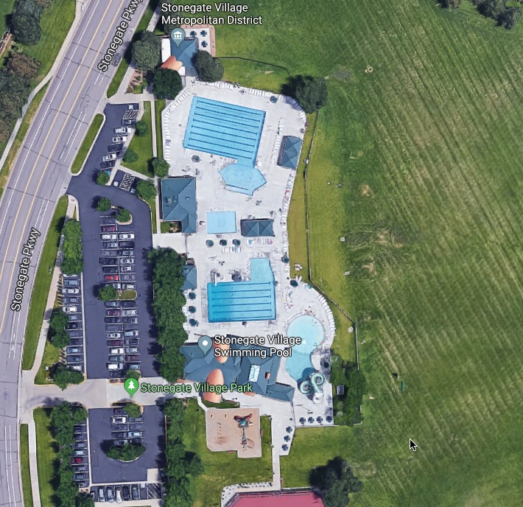






TEAM TENTS:
SH = Sundance Hills
BF = Ben Franklin
BMS = Bow Mar South
CCV = Cherry Creek Vista
CK = Cherry Knolls
FP = Forest Park
GO = Green Oaks
HTS = Hampden Heights
HG = Heritage Greens
HV = Heritage Village
HOM = Homestead
HF = Homestead Farm
HFII = Homestead Farm II
HH = Hunters Hill
South Park = SP
Stingray = Stonegate
K = The Knolls
P = Preserve
WC2 = Willow Creek II
SG BOD & PR = Stonegate Board of Directors and Parent Reps Tent
= Coaches Chairs (Spots to be marked day of finals)
RETAIL/FOOD/Other
= Out of Bounds = Heating
= Snowie
= Concessions
= Maui Wowie
= Announcers/DJ booth
SH
BF
BMS
CCV
SG BoD & PR
CK
FP
Scoring
GO
HTS
Championship Pool #2
HV
HOM
HF
HF II
HG
HH
SP
WC2
P
K
SOUTH Warm Up Pool #1

Slide 2
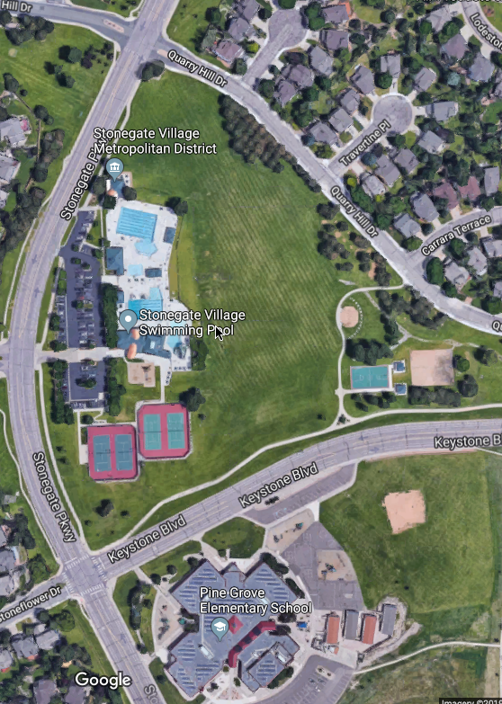


PARKING KEY:
Yellow Arrows = Safe Parking
Red Arrows = violators will be ticketed – NOTE THE BIKE LANES
= Coaches, Parent Rep (1 of each per team), and RMSL Board Parking ONLY
= Resident/Tennis
Parking only
NOTE: There will be parking monitors on duty
v
v
v
v
v

