Slide 1

Computer Official Training
Evan Hein NWAL 2nd VP – Computers

Slide 2


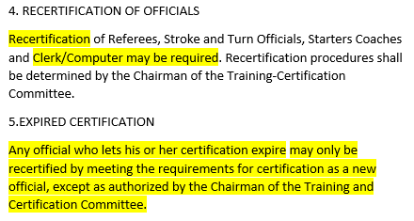
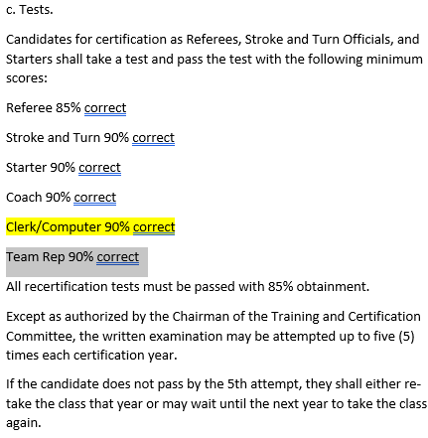
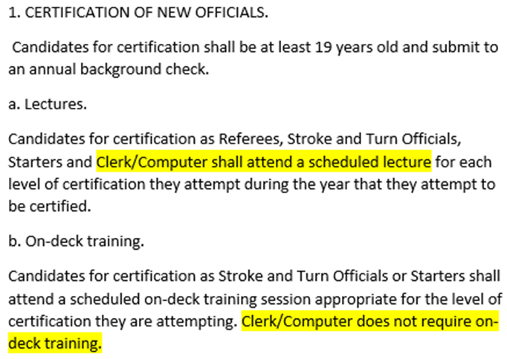
Certification
Notes:
No recertification yet, but this is probably coming
You are required to wear “Official” attire
Wear your badge, which means you have to complete the background check

Slide 3
Requirements
From the Rulebook:
1. CERTIFICATION OF NEW OFFICIALS
Candidates for certification shall be at least 19 years old and submit to an annual background check.
You must have and wear your badge when you are working as a computer official!
B. OFFICIALS' ATTIRE
While officiating during any regularly scheduled NWAL swim meet, including Divisional Meets and Invitational Meets, Referees, Stroke and Turn Officials, Starters, Clerk of Course, and Computer Certified Personnel shall wear a standard uniform which bears no writing, symbol, insignia, or other mark identifying the official's NWAL swim team affiliation. The standard NWAL uniform shall be a white collared shirt with sleeves (Sleeves or cap sleeves are allowed for ladies) and navy-blue pants, shorts or skirt. NWAL Board approved shirts with NWAL insignia may be worn on deck by only qualified officials.

Slide 4
Computer Official Duties
The Computer Official responsible for each meet shall
Be provided with NWAL software and be responsible for their team’s athlete data
Be provided with the meet entries for each upcoming meet according to the schedule
Ensure that meet entries use the correct entry time for each athlete’s events, and that each athlete is entered in the appropriate events for the meet, and their age and gender
Be provided with an area where times and results are collected after each event
Be responsible for entering the meet information during the meet
Record the times of each athlete in all events according to the rules of the Timing System in use at the meet.
Enter athlete disqualifications into the meet results with the athlete’s infraction
Present the team scores to the Meet Referee at the conclusion of the meet, and transmit the results back to SwimTopia.

Slide 5
Meet Schedule
Season meet schedule will be pushed to your team’s site by Swimtopia
Once pushed, any changes to date or location need to be changed by each team in their own site
Invitational meets will have templates available for you to use when adding them to your schedule
Do not use prior years’ templates or attempt to enter the meet yourself, as the time standards may have changed

Slide 6
Demo
Meet schedule, creating meets.

Slide 7
Entries
An individual athlete may compete in a maximum of 5 Events at a Dual or Divisional Meet
3 Individual Events and 2 Relays
For a Divisional meet, a Division may elect to allow athletes to swim in 3 relays
ALL official meets require an entry time. Only at Time Trials can NT be used as an entry time.
Entries for Divisional and End-of-Season Invitational Meets may not use Unofficial Times
To participate in a Divisional Meet, athletes must participate in 2 NWAL Certified Dual Meets
Participation is defined as an athlete entering the water in an NWAL event with or without disqualification (otherwise known as a splash), and with or without completing the race

Slide 8
Swim-Ups
An athlete may “swim-up” in a different age group in a Dual or Divisional Meet
During the meet an athlete must swim all individual events in same age group for the entire meet. They may not move up and down during the same meet.
At the scratch meeting a team may move an athlete officially entered in the meet from a lower age group into a relay for a higher age group (up to two age groups) of the same gender provided that the team does not have enough athletes in the higher age group available.
The athlete moved into the higher age group for one or more relays may remain in all individual events originally entered in the lower age group.

Slide 9
Entry Times
Two classes of times obtained by an athlete:
Unofficial time: obtained outside of an official meet (i.e., Time Trials or at practice), with or without disqualification
Official time: achieved in a Dual, Divisional, or Invitational Meet, and swim without disqualification
An Official time must be used as an entry time if one is available from the current season, even if it is slower than an Unofficial time
Dual Meet and mid-season invitational entries may include Unofficial times as long as they do not have an Official time
Mid-season invitational qualifications are always at the discretion of the meet host

Slide 10
Meet Exchange
In Swimtopia both teams lock out all entry changes and then click on the merge status button to indicate they are ready to merge. The home team is then able to merge the meet (option shows up once both teams indicate they are ready to merge).
If you want to include team records in heat sheets, they must be selected BEFORE the merge
This must be done by Thursday at 6:00PM (unless otherwise agreed upon by both teams) before the meet, and a PDF of entries generated from SwimTopia and sent to the other team
The PDF is important because Meet Maestro can be changed after the merge; the PDF serves as the official entry record

Slide 11
Demo
Entries, building the meet, entries report.

Slide 12
Scratch Meeting
The morning of the meet a team may scratch an athlete they know is not attending
The Meet Referee may instruct the Computer Official to re-seed the meet after the Scratch Meeting
The Clerk of Course shall be provided with the official entry list as revised at the scratch meeting (i.e. new Heat Sheets must be provided to the Ready Bench)
All scratches that have occurred after the printing of the heat sheet shall be reported to the Clerk of Course
If an athlete that is scratched (but included in meet entries) shows up to the blocks in time to swim, he/she shall be allowed to swim

Slide 13
Seeding
In each event, athletes shall be seeded so that a heat progression occurs from slowest to fastest
The last heat (fastest) should always be seeded full
No heat should be seeded with fewer than three athletes, but subsequent scratches may reduce the number to less than three.
If there are not enough athletes for all heats to be full, the first heat should be "short". If the first heat has less than three athletes, then one or two athletes from the outside lane(s) in the second heat should be advanced to the first heat to assure the minimum of three.

Slide 14
Timing Systems
Four approved Timing Systems:
Manual: Stopwatches
Semi-Automatic: Time Drops and Dolphin Timers
Automatic: Touchpad (Colorado/Daktronics)
Manual Watches
Three (3) timers (people) per lane, each operating a watch, unless there are not enough timers available for 3 in every lane, in which case a meet may proceed with 2 timers per lane
Semi-Automatic (Time Drops, Dolphin)
Must use at least two (2) timing devices per lane
Additionally, must have at least two (2) manual watches per lane
Touchpad: see NWAL touchpad protocol

Slide 15
Relay Alternates
Alternates for the four athletes entered in a relay once the meet has started:
Any athlete entered in the meet is an alternate for any relay of their gender and their age or any older age group
Work with Head Timer/Scribe to ensure the athlete’s name is verified and written down on the lane timer/scribe sheet
Athletes in a relay team may not be substituted at the block
The order of athletes within a single relay can be changed at anytime, including while the race is in progress. Once at the block, athletes may not be moved from an “A” relay to a “B” relay.

Slide 16
Demo
Scratches, re-seeding, timing system configuration.

Slide 17
Determining Official Time
Rulebook:
If three watch times are available, and the difference between each time is less than 0.3 seconds, the time of the intermediate watch time shall be the Official Time.
If three watch times are available, and the difference between any time and its nearest other time is greater than or equal to 0.3 seconds, then the time with the greatest difference from its nearest shall be discarded and the Official Time shall be the average of the two remaining watch times. Any digits representing thousandths of a second shall be rounded up to the next slowest hundredth. The discarded time shall remain legible on the scribe sheet.
If only two watch times are available, the Official Time shall be the average of those two watch times. Any digits representing thousandths of a second shall be rounded up to the next slowest hundredth.
If only one watch time is available, the time of that watch shall be the Official Time.
If no watch times are available, the Meet Referee shall determine the Official Time by adding or subtracting 0.01 second to the nearest Official Time in the heat based on the observed order of finish. If no order of finish is available, the Meet Referee may use an unofficial watch time, or offer the swimmer the option of re-swimming the event.
IMPORTANT: All times used to calculate Official Time shall be transferred from the scribe sheet to the meet results!

Slide 18
Determining Official Time
Meet Maestro will highlight a time in red if it is more than 0.3 seconds from the other two – Meet Maestro will automatically exclude this from the calculation of the time
If you are using a semi-automatic timing system, and one or no times are available in a lane, or the two times available are more than 0.3 seconds apart, use the backup manual times from the scribe sheets
Appendix D – Outliers
The guiding principle is that preference is given to the times-based order of finish until it can be demonstrated convincingly that there was a timing error
If spread between watches >= .3, reason to believe a timing error
If inconsistencies do exist, assume the outlying watch does not exist and recalculate the times

Slide 19
Determining Official Time
 |  |  |  |  | Official Time
Heat 1 | 61.20 | 61.25 | 61.17
61.20
Heat 2 | 54.50 | 54.96 | 54.57
54.54
Heat 3 | 52.60 | 52.95 | 53.23
53.09
Heat 4 | 50.30 | NT | 50.62
50.46

Slide 20
DQs
Confirm with Meet Referee on where DQs will be written on the scribe sheet
Even if a swim resulted in a DQ, you should still determine the correct Official Time
Verification – teams need to agree on how and when a referee should verify the results of each event
Do NOT allow the Meet Referee to wait until the end of the meet to try and do this
No results should be posted until Verification has taken place

Slide 21
Disputes
During the meet – Only a Coach or Team Rep can raise a dispute, and only to the Meet Referee
Kindly but firmly direct parents, Board Members, and other folks to bring their disputes to their Team Rep
Only the Meet Referee may instruct you to make changes
After the meet – only time corrections are allowed (no dispute of DQs)
Time change requests should be sent to computers@nwal.org.
These must come from Meet Referee, copying all Team Reps for the meet.
Once all Team Reps reply with their approval, the time will be updated.

Slide 22
Scoring
Once you’ve entered all times for an event, Meet Maestro will highlight it in green. Click “Actions”, then “Results for Event” to print the results.
Dual Meets:
Individual Events 7-5-4-3-2-1
Relays 7-3
If the same team in a Relay gets 1st and 2nd, they will only get 7 points and the other team will receive 0
Divisional Meets
Individual events 14-12-10-9-8-7-6-5-4-3-2-1
Relays
5 Teams 14-10-7-5-3
6 Teams 14-10-7-5-3-1

Slide 23
Demo
Entering time, DQs, and printing results.

Slide 24
Finalize Meet
After all times and DQs have been entered and verified, print one copy the “Team Scores” report for each team, and have the Meet Ref sign them
If there is a tie, the tie-breaker shall be number of first place finishes, then second place finishes, etc. until the tie is broken
In the “Finish & Export” section, click “Lock out changes”, then click “Transfer Results” to transmit the results back to Swimtopia

Slide 25
Final Thoughts
Before the meet starts – confer with your Meet Referee and Team Rep on many heat sheets you need
Announcer, Ready Bench, Officials, Coaches
Avoid spectators around your computers setup
Protect your printed materials from wind!
Download Meet Maestro for Desktop if your device supports it
Meet Maestro Documentation, SwimTopia Documentation, and Training Videos

Slide 26
Next Steps
Wait for an email from me that I’ve updated your attendance in the class today
Sign in to https://nwalcertified.com and click “Take Official Test” at the top of the page
Pass your test! Don’t be discouraged if you don’t pass the first time…
Request your background check through Certified
Let your Team Rep know you’re certified, so you need a badge and access to your team’s website
Practice navigating SwimTopia and Meet Maestro before you run a meet
Have fun!

Slide 27
Thank you!
From myself, and on behalf of the NWAL, thank you volunteering to take on this important role.
Have a great season!

