Slide 1
Returning Stroke Judge Training
Rocky Mountain Swim League
Presenter
Kris Reese
kjreese@yahoo.com

Slide 2
The Stroke & Turn Judge
Knows the rules
Attends the officials briefing
Keeps a mental checklist:
  Be attentive during the stroke briefing
  Visualize the stroke before the event
  Consider the rules that apply to the event before the event
  Focus on your jurisdiction – no more, no less
  Be in the middle of the lanes to which you are assigned
  Consider your body language – you are “on camera”
  Enjoy your work – maintain a sense of humor!
  Remembers that the benefit of the doubt goes to the swimmer!

Slide 3
Pre-Meet Duties
Prior to the start of competition
  Be on time and in the right place for the stroke briefing; be attentive during the briefing
  Have a positive attitude!
  Wear the identifying shirt/vest as required
  Be ready and in position as requested by the Starter/Referee
  Test and wear a radio prior to arriving in position

Slide 4
During the Meet
Before each event
  Visualize the stroke
  Remember the rule requirements of legal stroke and transitions
  Always use “benefit of the doubt” observation protocol
After the start
  Be in position!
  Observe swimmers until they all depart your jurisdiction
  Give equal observation to all lanes in your jurisdiction, even the empty ones
  Raise hand promptly to signal an infraction
  Record infraction when you are able to in Swimmingly
  Discuss infraction with Starter/Referee, as necessary/asked
  During relay exchanges – look for toes leaving then hands touching
      For shallow end exchanges – hand of the swimmer leaving the wall must be on the wall when finishing swimmer touches the wall

Slide 5
Jurisdiction
Assigned by the Starter/Referee
  Half of the pool, between 2-8 lanes
  Fewer lanes if more Stroke & Turn Judges are available
Virtual Meets
  May be difficult to have 4 Stroke & Turn Judges on deck (2 on each end) at all times; easier if teams are swimming each other in person
  In Virtual Meets, both teams should have the same number of Stroke & Turn Judges on the deck
    Most fair to all swimmers in the meet!
No matter how much jurisdiction you have, always be sure to observe ALL lanes in your jurisdiction – avoids having some swimmers be “overjudged”

Slide 6
Reminders
Observe, don’t inspect
  The benefit of the doubt goes to the swimmer!
Call what you see, and see what you call
  DQ with pride!
Record DQs, even if swimmer already DQ’d
Raise your hand; get the Starter/Referee’s attention when you make a call
Don’t talk on the radio unless talking about a call with the Starter/Referee
Adapt to meet conditions; help where requested
Enjoy the work!

Slide 7
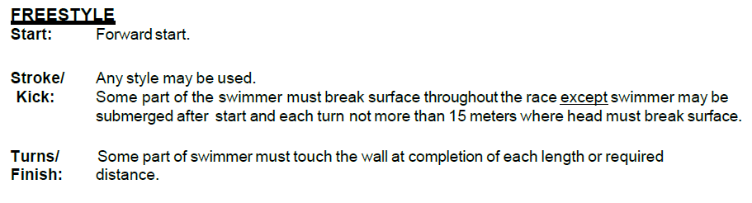
Stroke Briefing
Freestyle

Slide 8
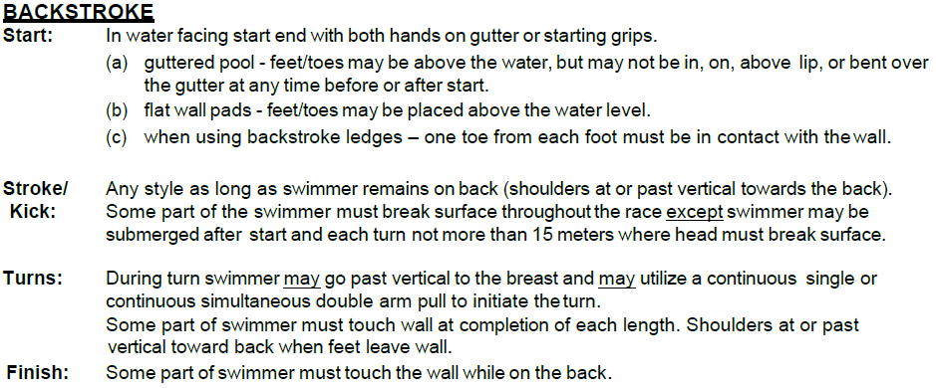
Stroke Briefing
Backstroke

Slide 9
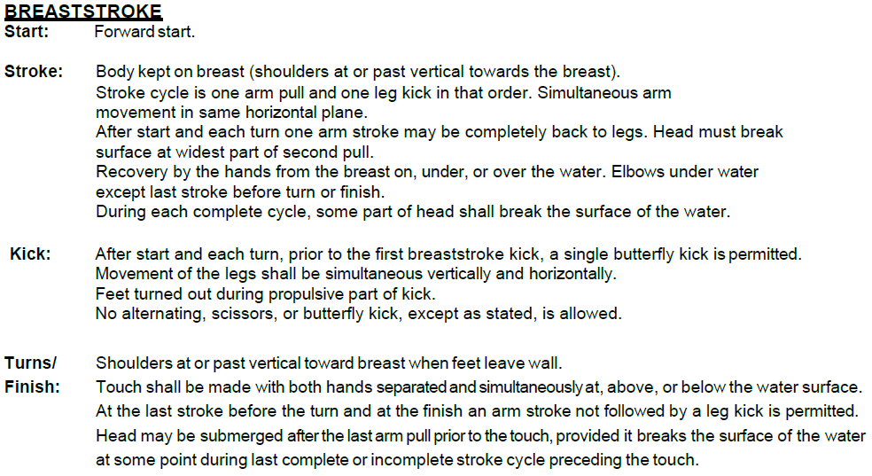
Stroke Briefing
Breaststroke

Slide 10
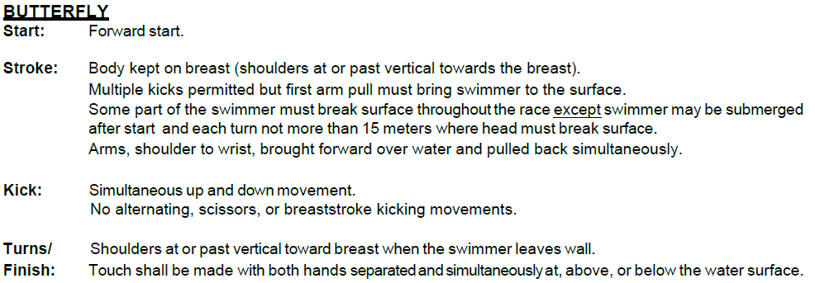
Stroke Briefing
Butterfly

Slide 11
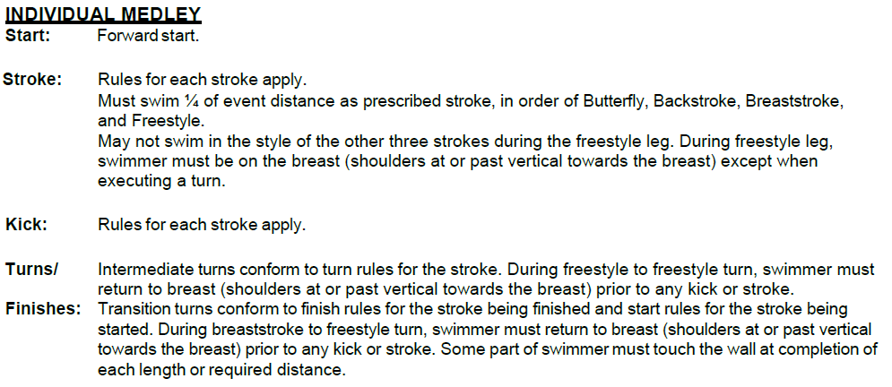
Stroke Briefing
Individual Medley

Slide 12
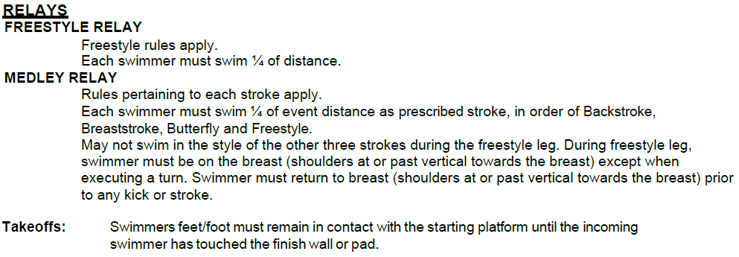
Stroke Briefing
Relays

Slide 13


Slide 14
Stroke & Turn Judge Situations
In the girls 10 & under 50-yard breaststroke, the swimmer leaves the wall with her shoulders past vertical towards the back. The S&T judge is talking with another parent, but observes the infraction and records the disqualification. What should occur and why?
Recommended Resolution: The call should not stand. Stroke and Turn Judges owe it to every swimmer to be attentive to every swim – if a judge is talking to a parent during one heat, but not the other, that’s not fair to all swimmers.

Slide 15
Stroke & Turn Judge Situations
A Stroke and Turn Judge positions themselves at the side of the pool instead of at the end of the pool. What should occur and why?
Recommended Resolution: The Starter/Referee should advise the Stroke & Turn Judge to position themselves at the end of the pool, centered as best as possible between the lanes of their jurisdiction. Any calls made by an out of position Stroke & Turn Judge are subject to being overturned.

Slide 16
Stroke & Turn Judge Situations
The Starter/Referee has jurisdiction over the entire pool. He/she notices an infraction in the pool and records it, without notifying anyone. What should occur and why?
Recommended Resolution: The call should not stand. Even Starter/Referees need to raise their hands to notify the pool of an infraction!

Slide 17
Stroke & Turn Judge Situations
A parent or coach doesn’t like one of your calls, and starts to vocally express their displeasure with you. What should occur and why?
Recommended Resolution: The Starter/Referee should notice this situation and advise a team parent. Stroke & Turn Judges are volunteers, as are all others on deck, and do not deserve any abuse. Also – if that parent doesn’t like your call, they should have volunteered!

Slide 18
THANK YOU
FOR YOUR TIME
See you on Deck

