Slide 1
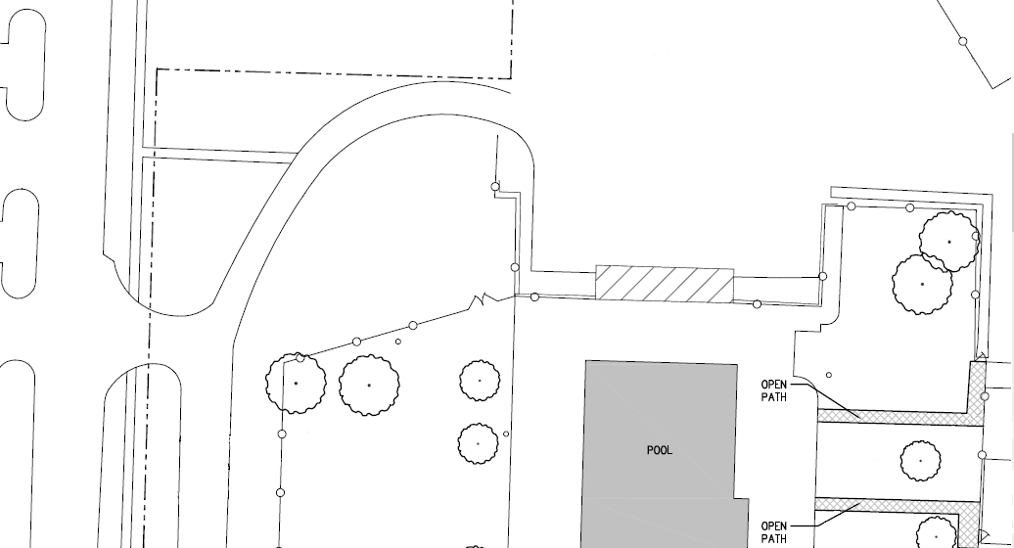
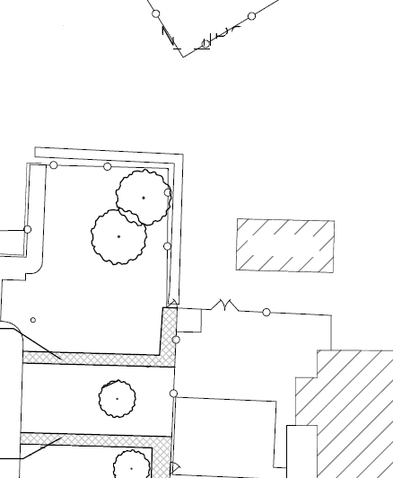
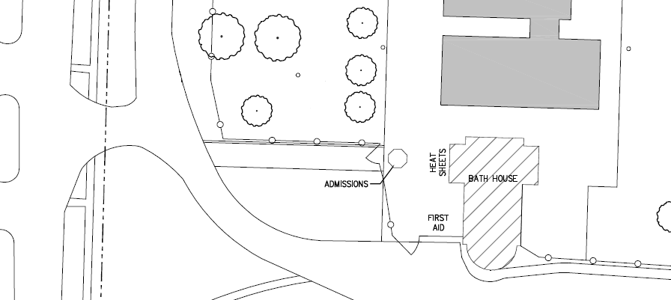
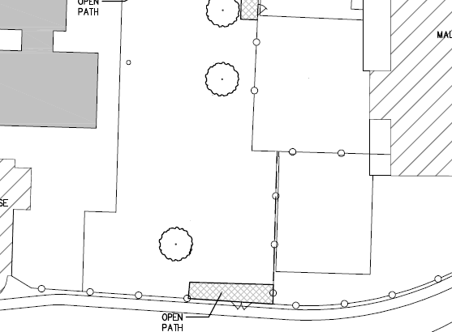
2019 NSSL CHAMPIONSHIPS
AT GREENHILLS POOL
TEAM LAYOUTS
NORTH
EVENDALE
40’x60’
SOUND
GRILL AND
CONCESSIONS
SCORE-
BOARD
GREEN
HILLS
20’x20’
SPRING DALE
20’x20’
TIMING
TABLE
COACHES
NORWOOD
SHARONVILLE
40’x40’
TENT
BLEACHERS
SWIMMER DROP OFF
CLERK OF
COURSE
HOSPITALITY
BLUE ASH
20’ x 30’
TENT
ST. BERNARD
20’ x 30’
TENT
BASKET RAFFLE
T-SHIRTS
SWIMSAFE
WYOMING
30’ X 45’
TENT
SWIMVILLE
KONA ICE
GRANNY’S GOODIES

