Slide 1
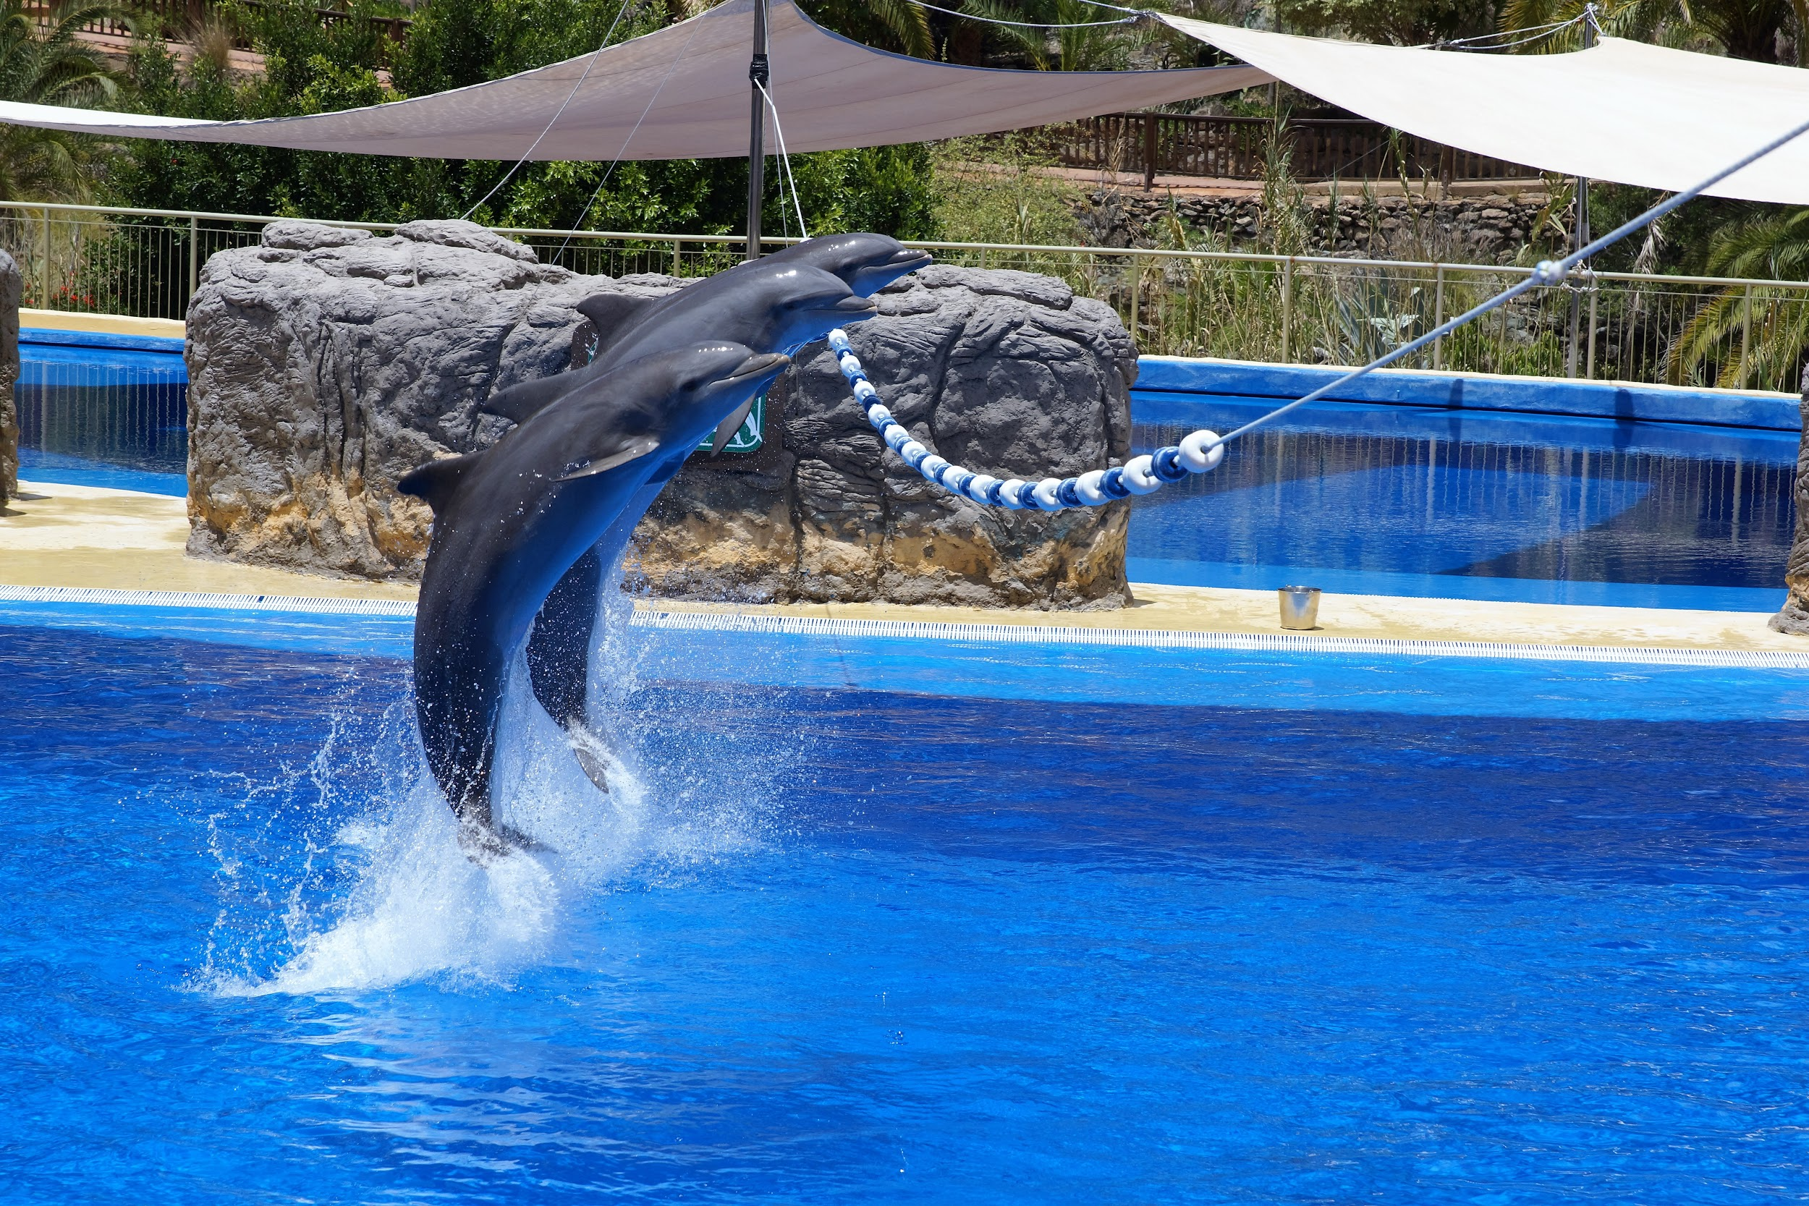
Dolphin Volunteers
An overview to helping our Swimmers!

Slide 2
Volunteering Basics - WE NEED YOUR HELP!
Each Dolphins family is asked to volunteer a minimum of 10 credits throughout the course of the season
There are many different types of positions to choose from in order to meet the requirements
Sign ups for meet day positions will be opened on SATURDAY MAY 30
Meet day volunteers will check in and receive instructions at the meet
If a family does not meet the minimum requirement, the credit card on file will be charged at the end of the season in accordance with LDST policy agreement signed at the time of registration

Slide 3
Why do we need Volunteers?
Running a meet requires many hands
To keep costs down, we rely on volunteers
Volunteering allows parents to become participants and understand the sport better
It’s important for swimmers and families to understand how much goes in to each event

Slide 4
What are the jobs?
Single Meet Positions
  Parking
  Set Up/Clean Up
  Rounders
  Timers
  Concessions
  Concessions Pick Up
  Assistant Clerk of Course (Sometimes)
  Runners
  Computer Operator Assistants
  Heat Winner Ribbon Distribution
  Stroke and Turn Officials
  Referee
  Starter
Special Events Help
  Parade
  Set Up/Clean up @ Parties
  Other occasional opportunities
Board Membership
Committee Chairs & Members
Season-long Positions
  Equipment Manager
  Ribbon Writer
  Clerk of Course
  Clerk of Course Assistant
  Concessions Assistant
  Computer Operators
  Head Timer
  Head Rounder
Descriptions for all positions can be found on the website!

Slide 5
How Do I Volunteer?
Sign Up on the Team Website
Show up on-time
Sign in at the event
Check in will be at the gate near the picnic tables for home meets. Location will vary during away meets, but is generally in our team area.
Perform the job in its entirety
If you have an emergency, please let the Volunteer Coordinator know ASAP so that we can identify someone to fill in temporarily!
Clean up/check out as relevant
Track your credits on the Team Website

Slide 6
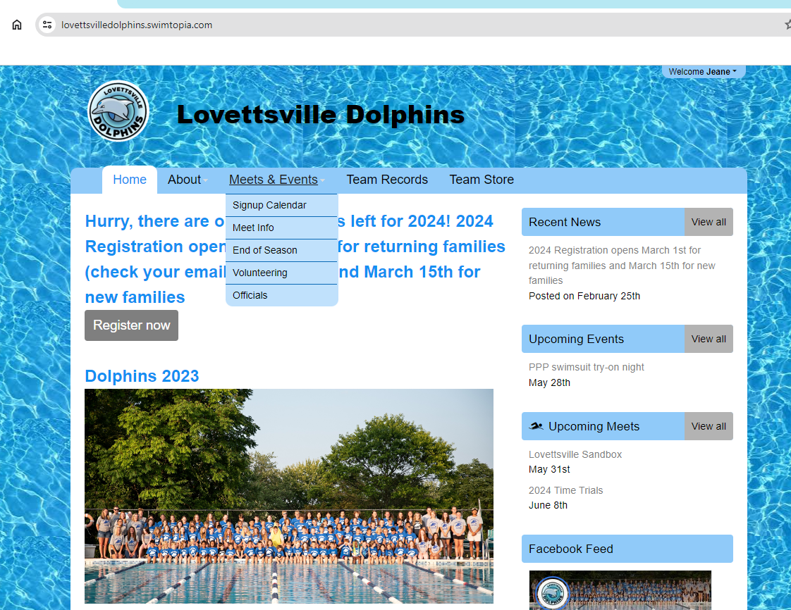
How Do I Sign Up?

Slide 7
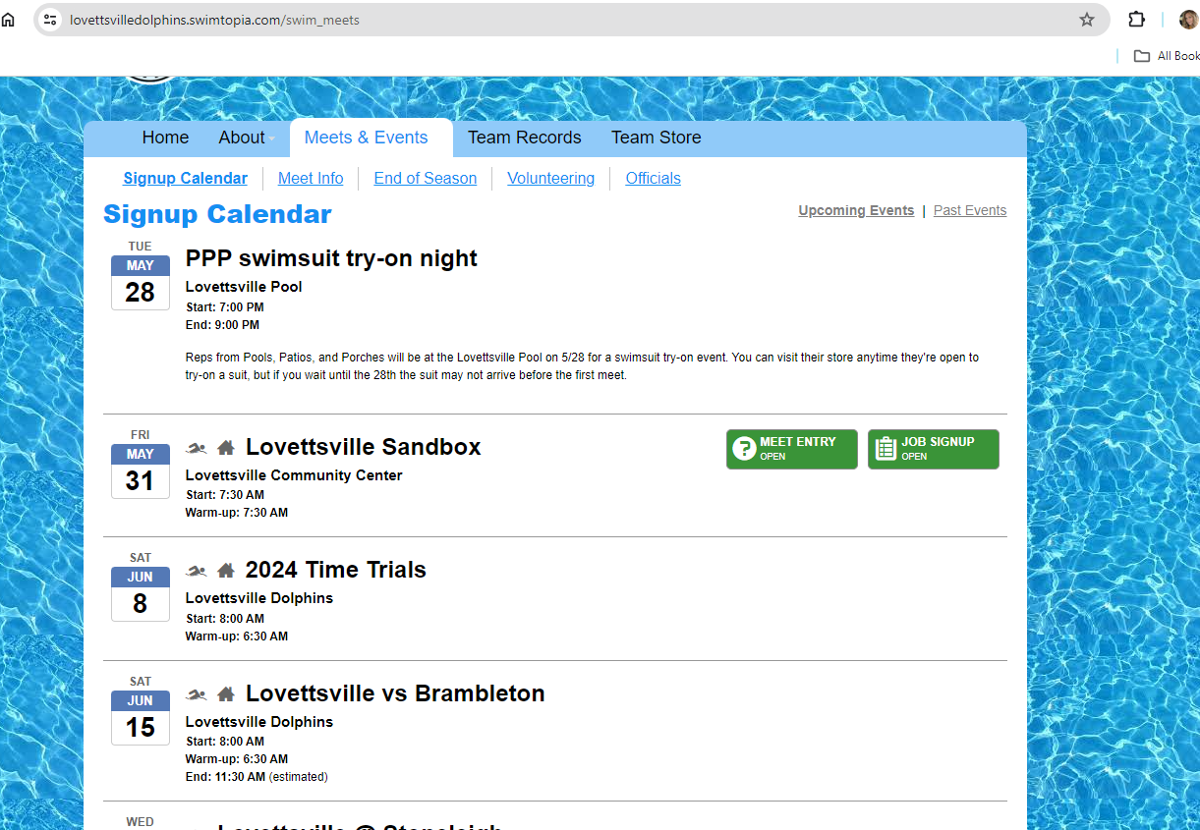
How Do I Sign Up?

Slide 8
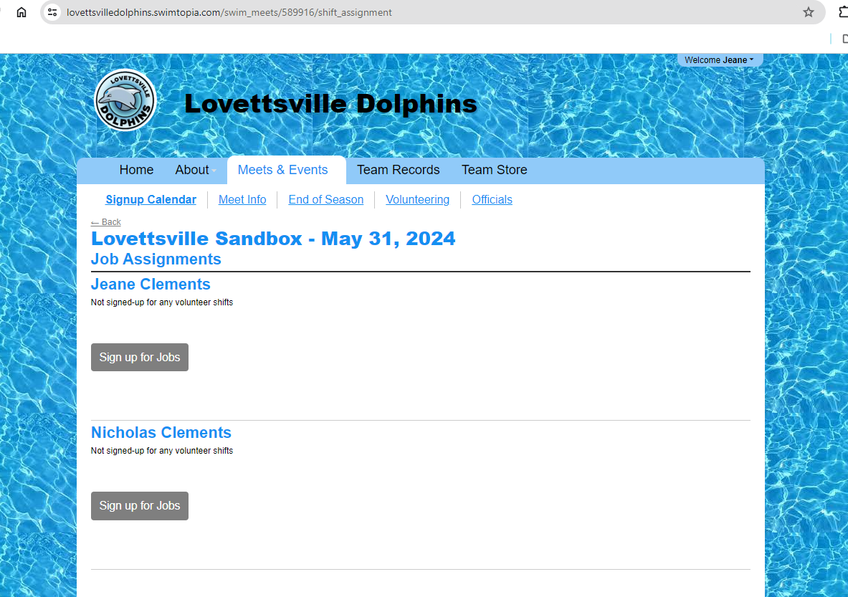
How Do I Sign Up?

Slide 9
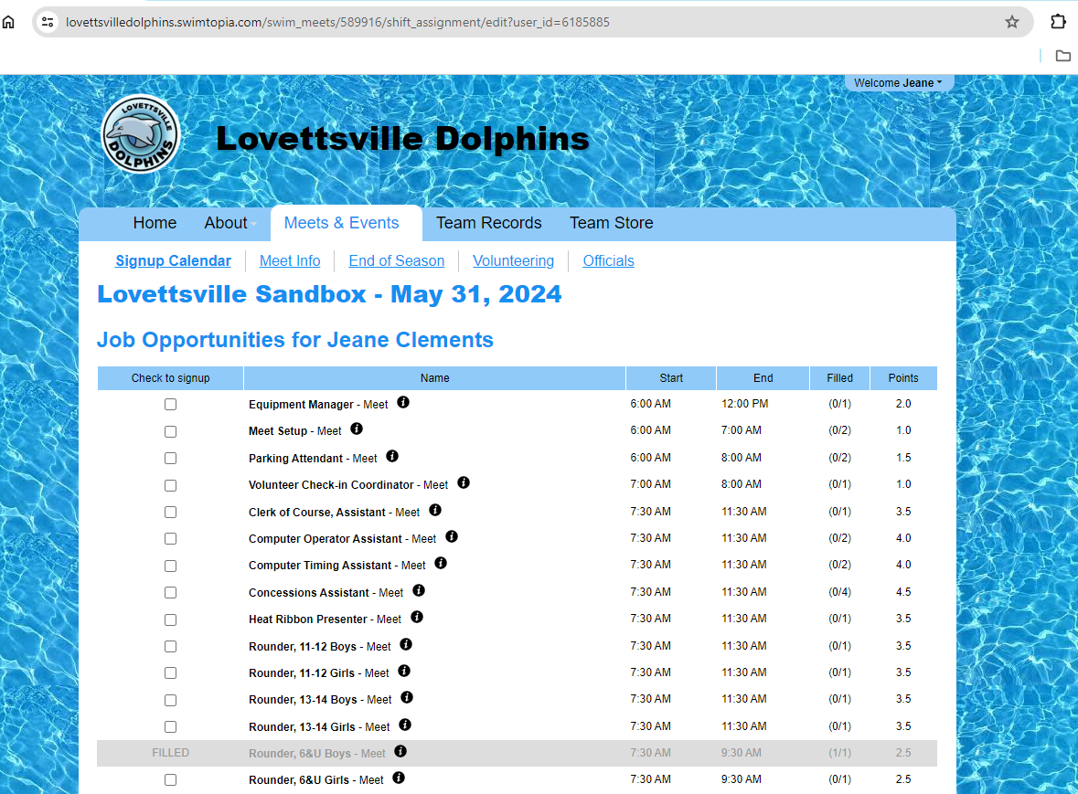
How Do I Sign Up?

Slide 10
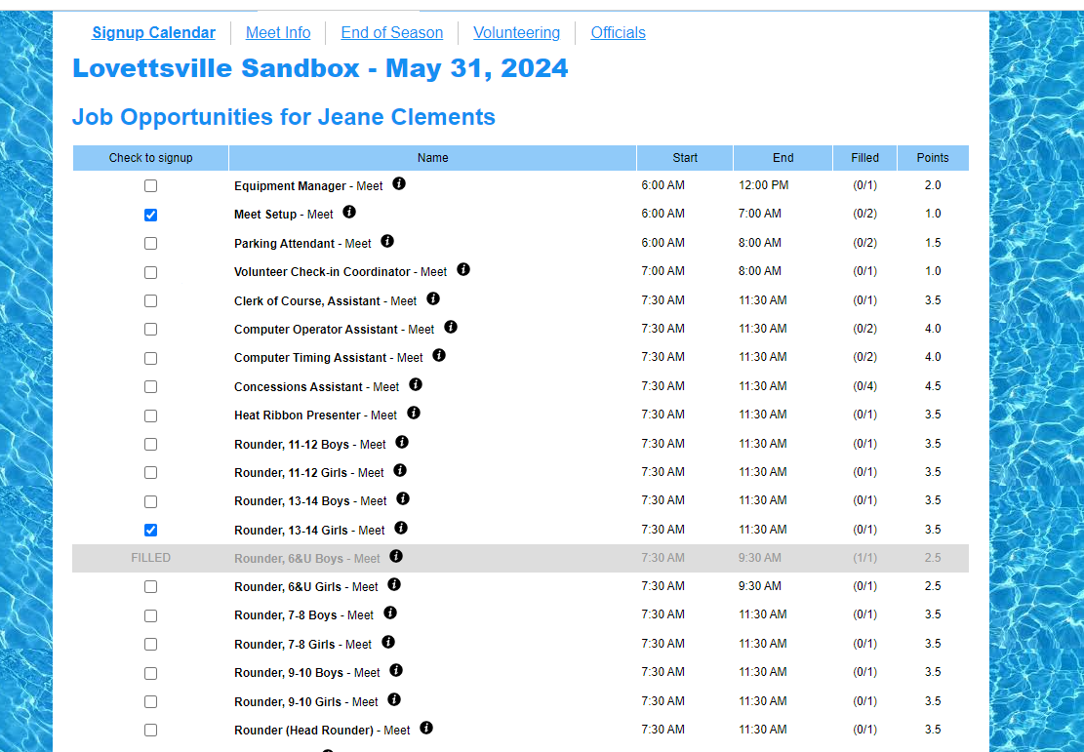
How Do I Sign Up?

Slide 11
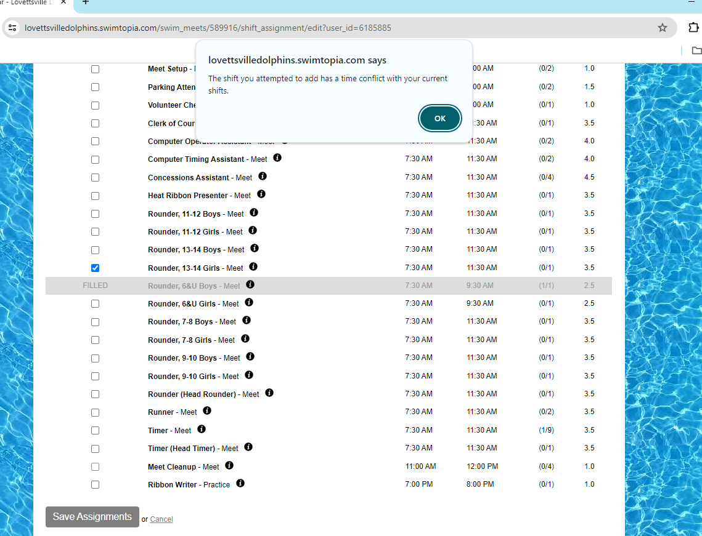
How Do I Sign Up?

Slide 12
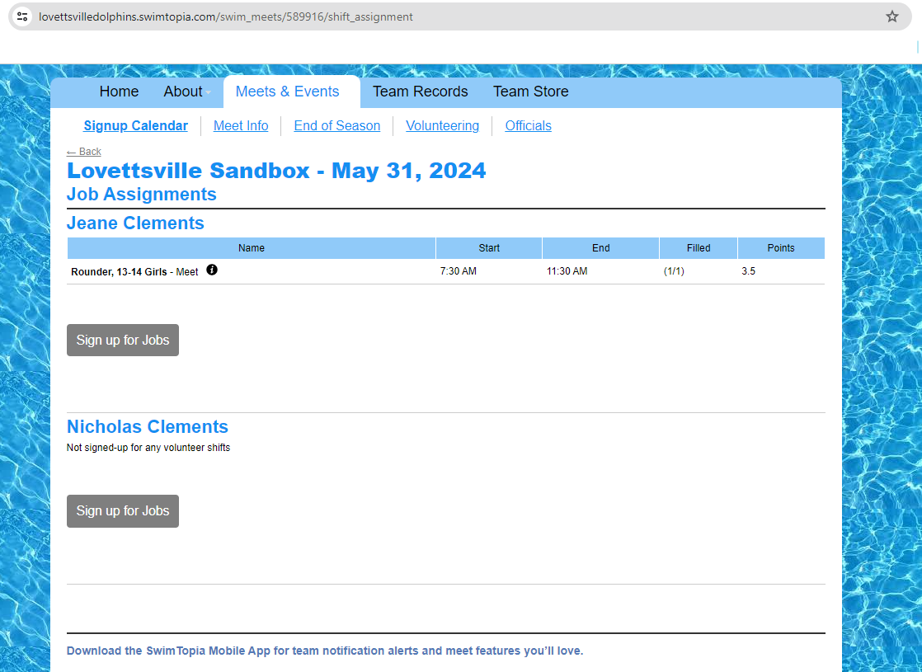
How Do I Sign Up?

Slide 13
How Many Credits Do I Need?
Each family needs to commit to and earn of 10 Service Credits per season.
IF YOU HAVE COMMITTED TO A JOB AND YOU WISH TO RECEIVE CREDIT FOR COMPLETING THE JOB, YOU MUST SIGN IN BEFORE THE EVENT - NO EXCEPTIONS.
Trying to track down individual volunteers on meet day creates a huge burden and takes away from the Coordinator’s ability to explain roles and responsibilities, coordinate with the other team, and check others in. Please do your part to help by checking in timely!
IMPORTANT: CREDIT VALUE DOES NOT EQUAL NUMBER OF HOURS WORKED. For ease of recording & reconciliation, each position is assigned a credit value. HOWEVER, if a position such as “Rounder” is allocated 3 Credits, this does NOT mean that the job is only 3 hours long. The volunteer has a responsibility to perform the duties throughout the entirety of the meet. Conversely, If the meet ends early, you will still receive full credit.
If you have an emergency and are unable to fulfill your commitment, please email the Volunteer Coordinator immediately. We will need to help you find a replacement!
After each event, the Volunteer Coordinator performs a reconciliation of credits based on the sign in sheets for each event. Families are responsible for tracking credits throughout the season using the report function on the website. If you find a discrepancy, or if you need help navigating the reporting function or job sign ups, please reach out to volunteers@lovettsvilledolphins.org
At the end of the season, a charge of $15 per hour not worked (of the required 10 Credits) will be charged to the Credit Card on file in accordance with the policy agreed to at the time of registration.

Slide 14
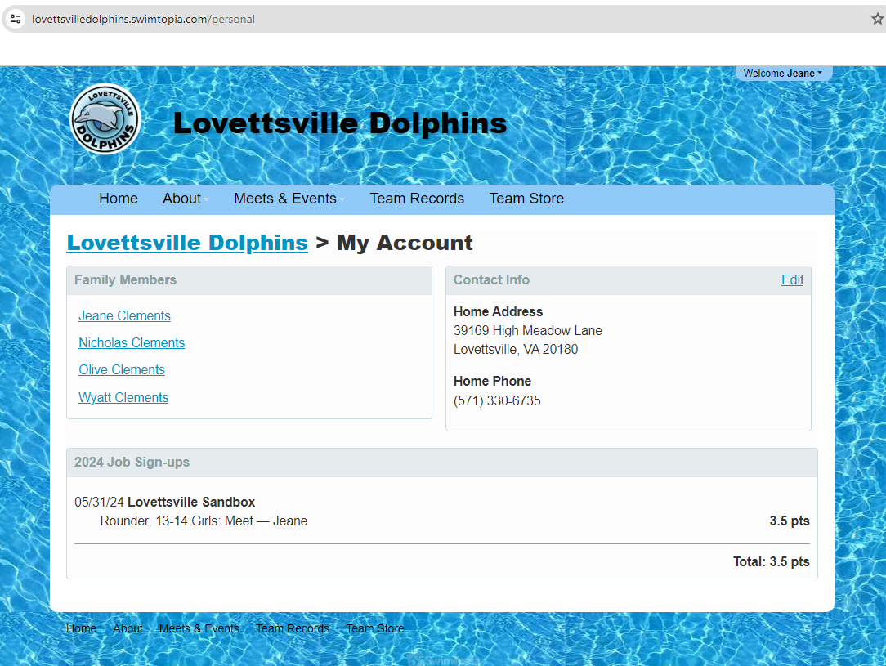
How can I see what I signed up for?

Slide 15
Questions?
Contact Julie Fischer, Volunteer Coordinator
Email volunteers@lovettsvilledolphins.org anytime
Or just ask at any practice/meet/event!

