Slide 1
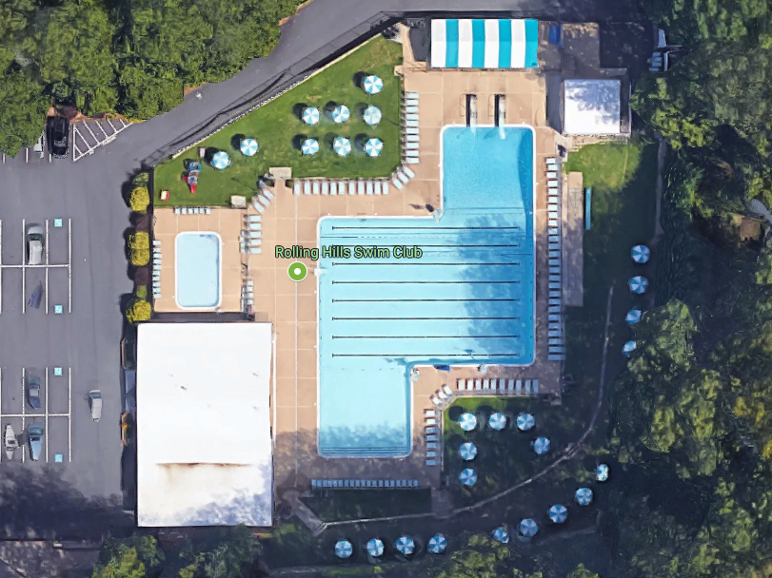
Table Workers
SOR
HF
Clerk of Course Overflow
Team Reps
SB
Clerk of Course
Spectators
THA
Coaches
KR
RH
Spectators
Spectators

